Slide 1
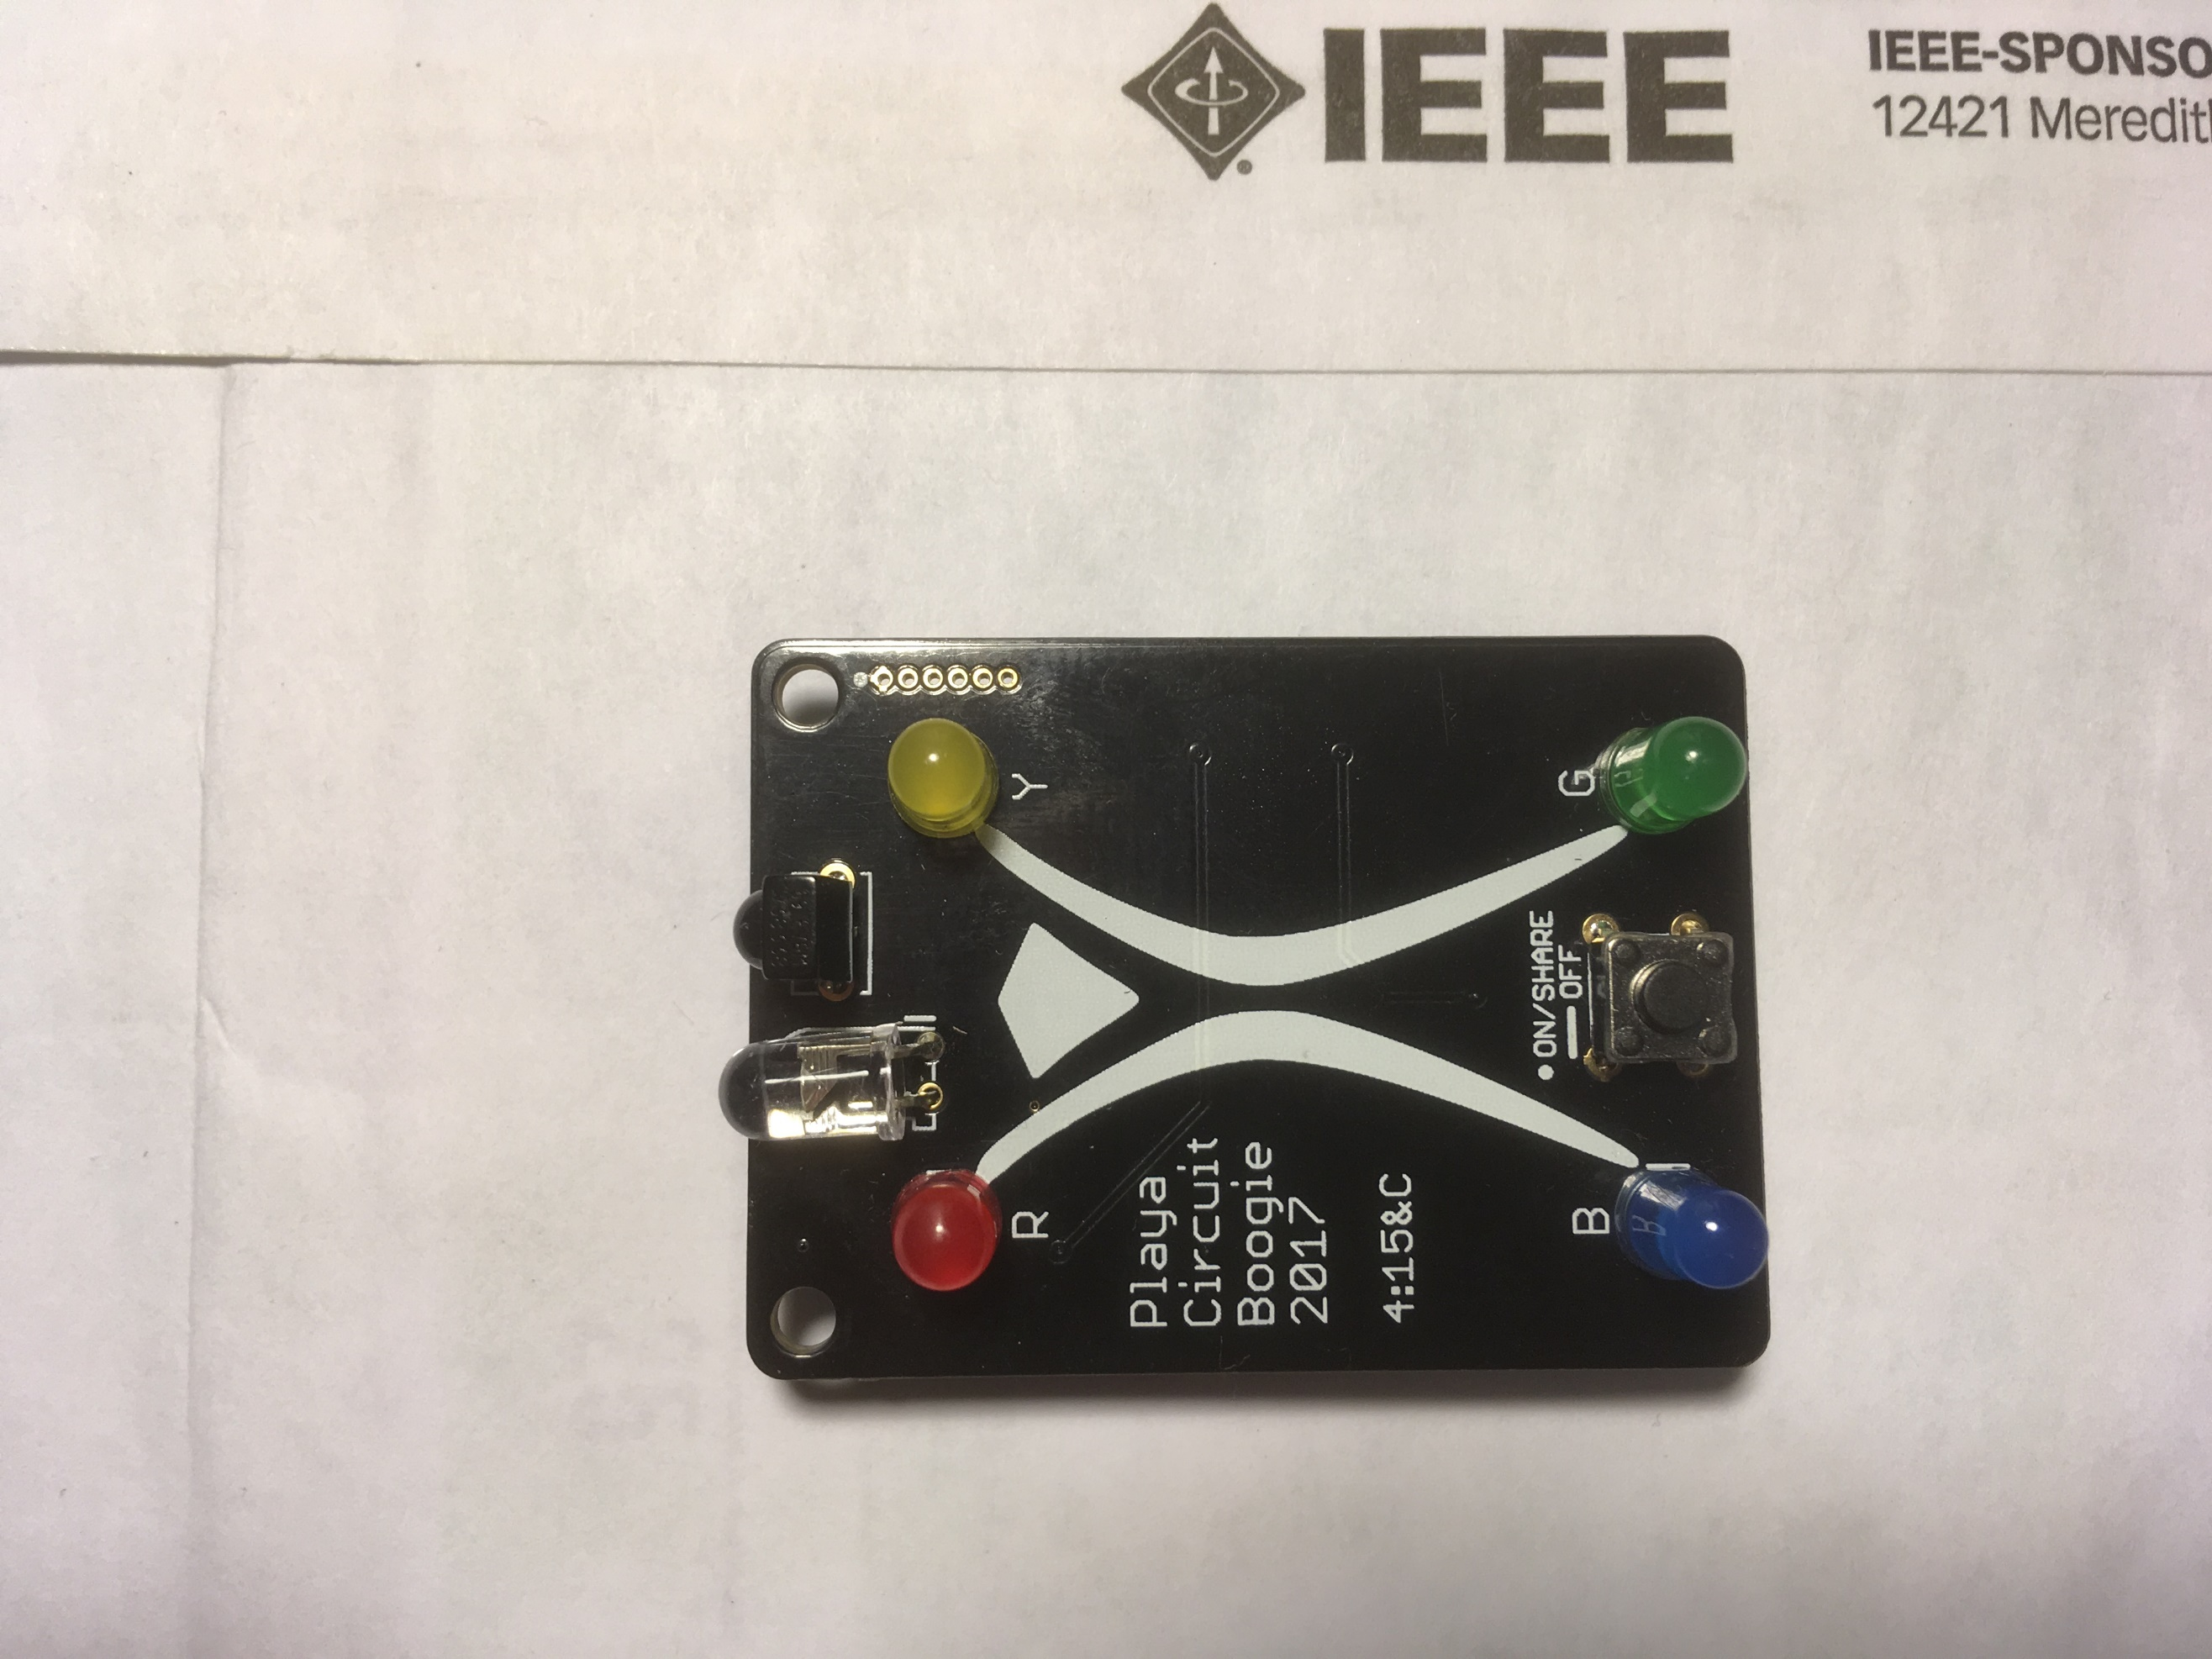
Playa Circuit Boogie
These instructions will help you solder together your very own PCB color widget so you can collect all four colors and light up the Man!
Just like a puzzle box, the picture above shows the final product, follow the instructions on the back and refer to this picture to put it together.
Once you’re done, and pop in the batteries, the lights should start flashing, press the button once to get your first color. Then:
Find someone with a color you don’t yet have
Point the clear and black LEDs facing outward on the two PCBs towards each other (like above) and press the buttons once at the same time
You’ll get a color you don’t have that your new friend does. If multiple colors blink, then you don’t have any of those: press the button once to decide which one you get
If you have a color your new friend doesn’t have, they’ll get that color
You can only trade colors with a person once! If you try again, your PCB will flash the color you got from them already to remind you
Hold the button briefly until the lights go out to turn off. Press once to turn back on. Save it for the nighttime! If the batteries die, it will still remember what colors you have, so come back around and see if we have spares
If something goes terribly wrong, hold the button for about 30 seconds, until the lights start flashing again. This will reset you all the way back to the default
If you love this project and want to check out how we did it, follow the link printed on the back of the PCB when you get home
Have fun and try to collect all the colors (and three new friends)!

Slide 2
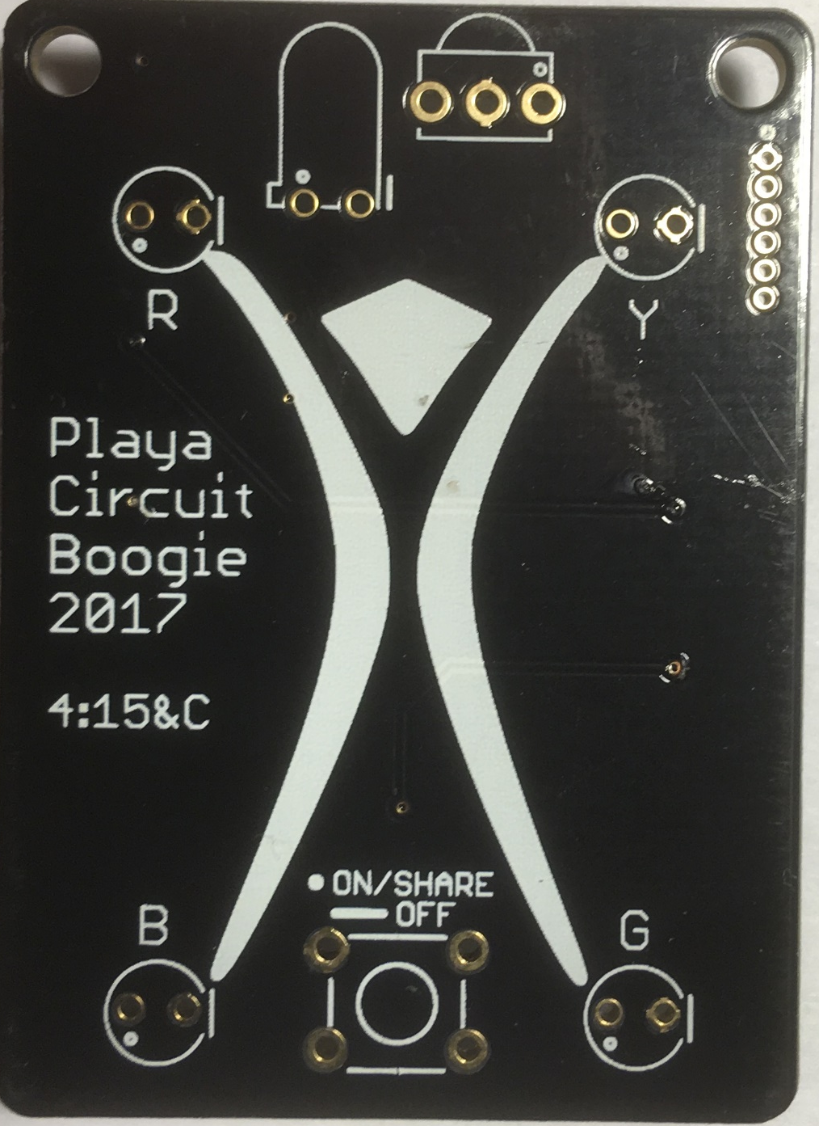
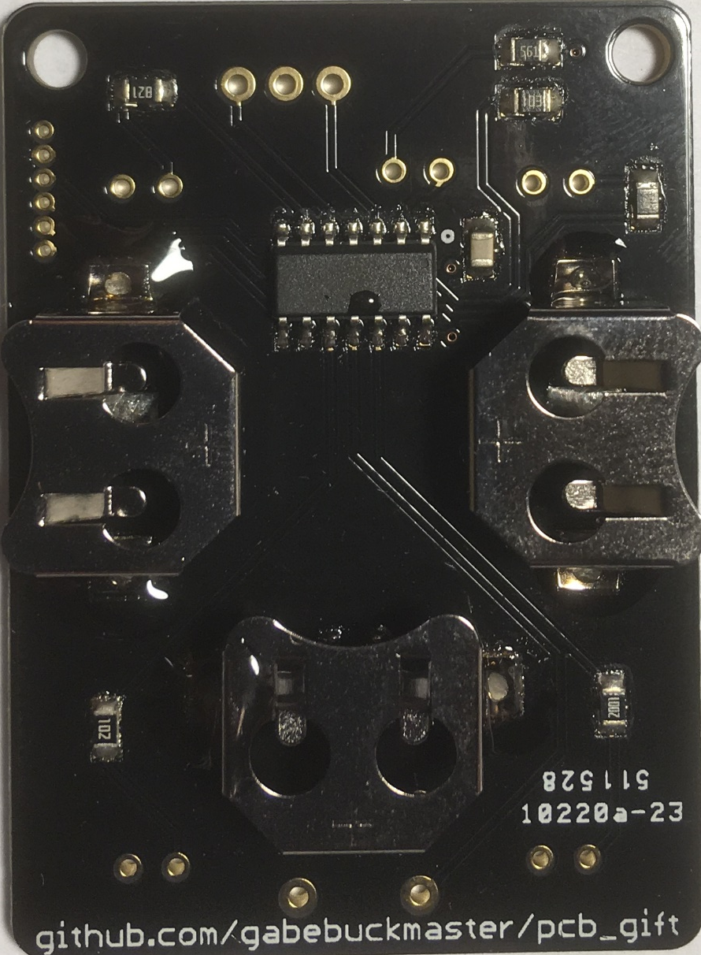
1
Start with the clear LED, this is the IR transmitter. Slot it into the correct holes (see tip below), and bend it over 90 degrees to face out, like the outline shows. Solder this from the back.
Tip: the symbols on the board show a dot for where the longer leg goes, and a flat bar that corresponds to the flat edge of the LED.
Front
2
Second, solder on the IR receiver. The bump should face outward. If it ends up crooked, gently bend it to be straight up and down.
3
Third, solder the button. It has four legs and only fits on in one orientation: with the legs on the left and right sides, not the top and bottom sides. The bottom two connections are mandatory, the top two are optional.
4
Fourth, put each colored LED in its corresponding place, R – Red, Y – Yellow, B – Blue, G – Green. Pay attention to the tip above to get them in the right orientation. If you mix and match the positions, some LEDs may be brighter or dimmer, or not turn on at all!
Back
5
Clip off the ends of the legs at the base while firmly holding on: avoid eye damage and MOOP from flying parts! Insert three batteries into the metal holders on the back. The lights should start flashing, press the button to get your first color!

